Slide 1
Welcome to
Smart Home Automation Project

Slide 2
Presented by
Al Amin CSE2102023107
Tuhin Alam CSE2102023013
Md. Wahidul Islam CSE1903018021
Md. Sazal Ahamed CSE2102023109
Under the supervision of, Md. Rashedul Islam
Lecturer, Department of Computer Science and Engineering Sonargaon University

Slide 3
Objective
The main objectives of home automation are controlling, management, and co-ordination of home appliances in a comfortable, effective, and secure way.
Enhance Living Experience
Increase Security
Optimize Energy Usage
Streamline Daily Tasks

Slide 4
Components
HC-05 Bluetooth Module
Light Dependent Resister
LED (generic)
Buzzer
Arduino UNO
LM35 Temperature Sensor
Relay Module
Jumper Wires
Fan/light bulbs

Slide 5
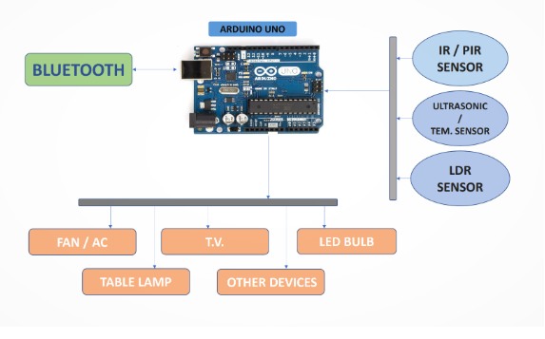
Diagram

Slide 6

Output

Slide 7
Key Features
Remote Access: Control devices from anywhere with an internet connection.
Integration: Interconnectivity between various devices and platforms for seamless automation.
Customization: Tailor automation to individual preferences and routines.
Safety: Alerts and notifications for unusual activities or emergencies.

Slide 8
Advantage
Convenience: Control devices remotely via smart phone apps or voice commands.
Energy Efficiency: Optimize energy usage through automated schedules and sensors.
Security: Monitor and secure home with smart cameras, doorbells, and locks.
Comfort: Adjust temperature, lighting, and ambiance according to preferences.

Slide 9
Limitations
Compatibility Issues: Some devices may not be compatible with each other or require additional hardware/software for integration.
Initial Cost and Maintenance: High upfront costs for purchasing devices and ongoing maintenance expenses.
Technical Complexity: Setup and configuration of smart home systems may be challenging for some users.

Slide 10
Future work
Smart Thermostats: Adjust temperature settings based on occupancy and weather.
Smart Lighting: Control lights remotely, set schedules, and adjust brightness.
Security Cameras: Monitor home and receive alerts for suspicious activities.
Smart Locks: Lock and unlock doors remotely and provide access to visitors.

Slide 11
Conclusion
Smart home automation offers numerous benefits in terms of convenience, efficiency, security, and comfort.
While there are limitations and challenges, addressing these issues can lead to more robust and reliable smart home systems.

Slide 12
Thank you

